Slide 1
Lab 10 Submitted to: Sir Ab Ghafoor
Name: Liaquat Ali
Roll No: 0029

Slide 2
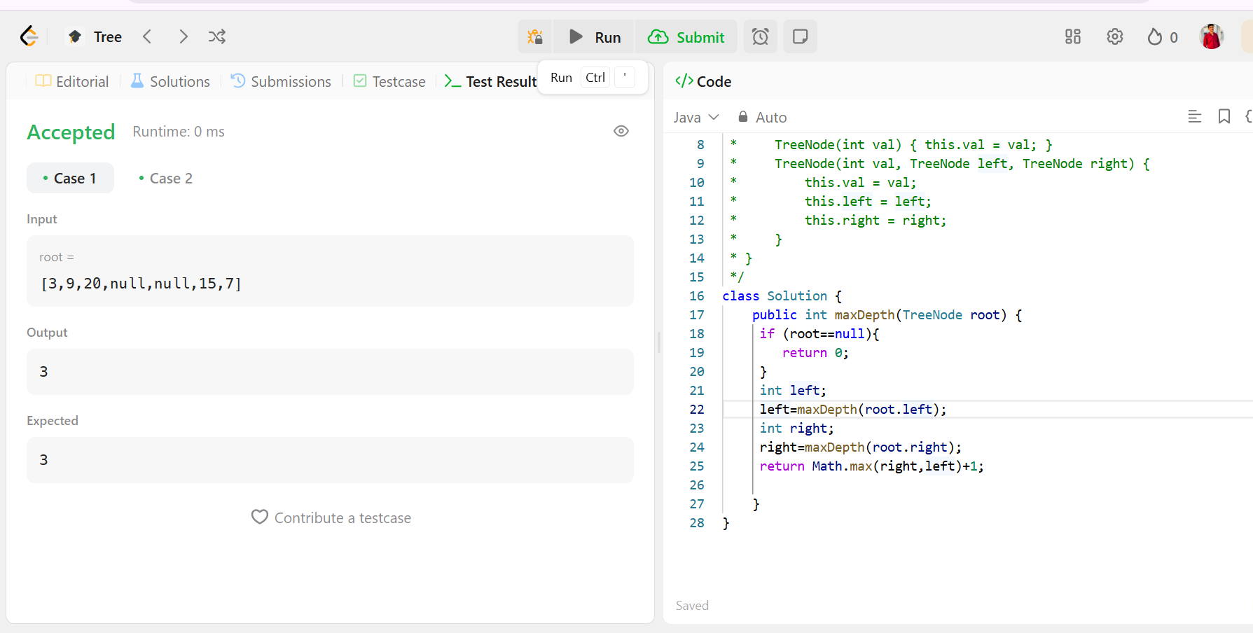
Task2:

Slide 3
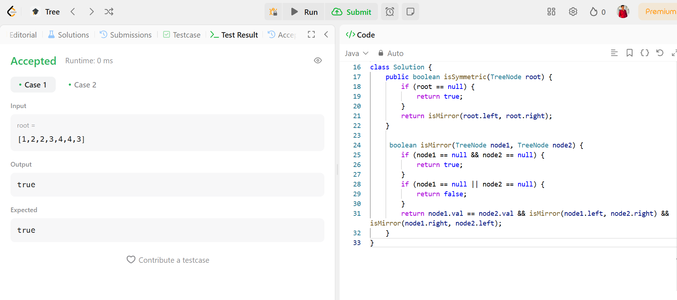
Task 02

Slide 4
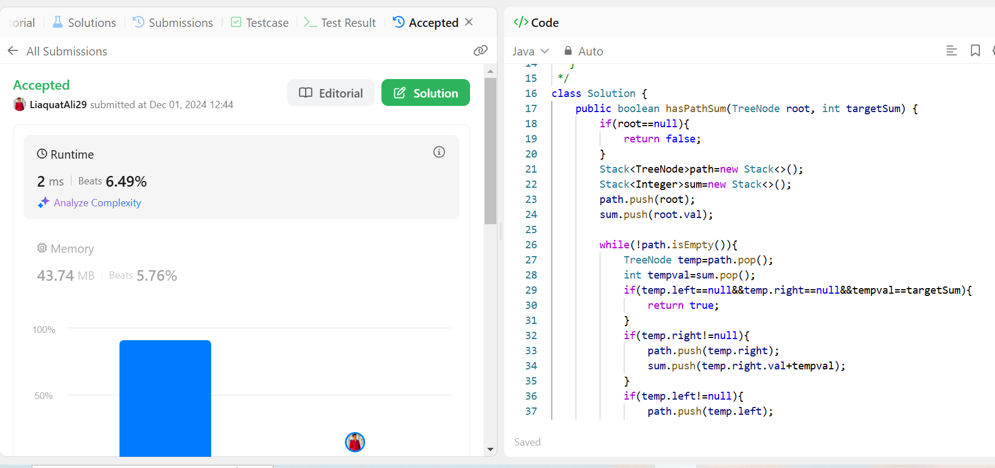
Task 03

